Slide 1
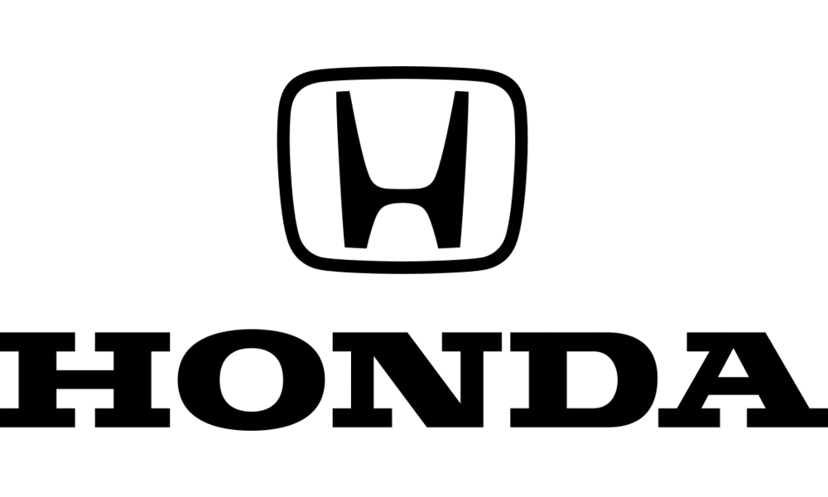
#2 PROJECT WORK: BUSINESS CASE
Margherita Botticelli, Nicola Bozzi, Andrea Cadoni, Eneriko Caushllari, Benedetta Pajadan, Francesca Rignanese

Slide 2
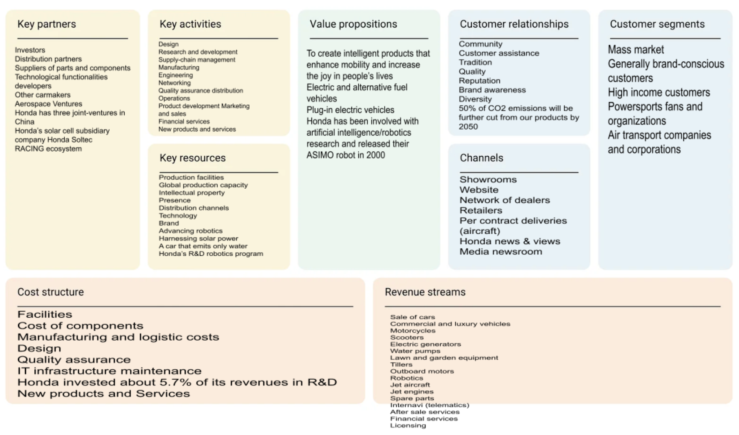

Slide 3
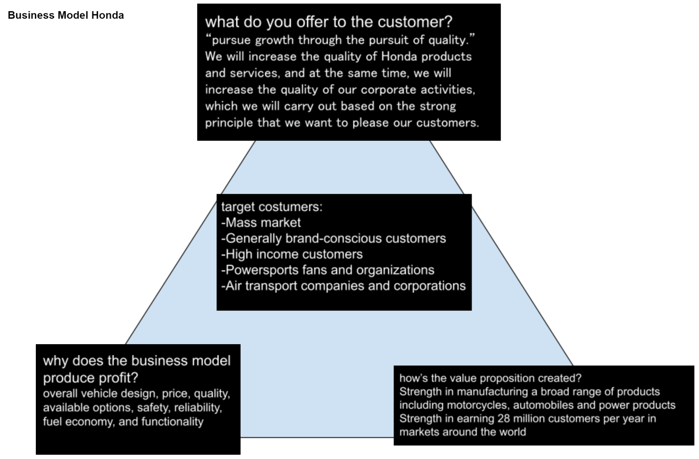

Slide 4
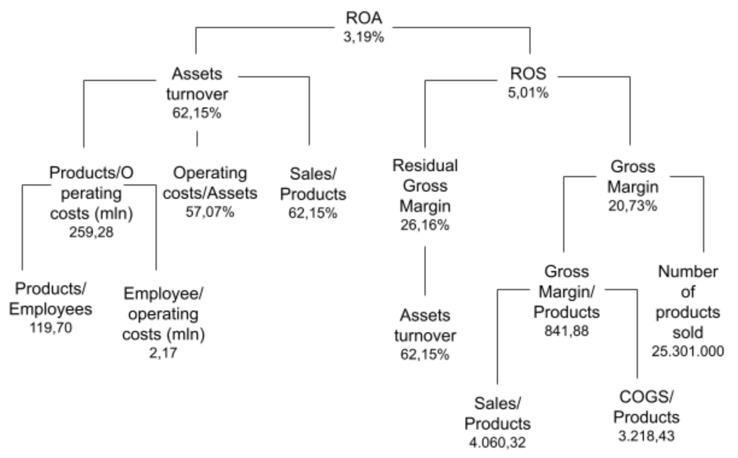
BUSINESS PERFORMANCE BREAK DOWN
*see PDF/EXCEL for more in depth analysis

Slide 5
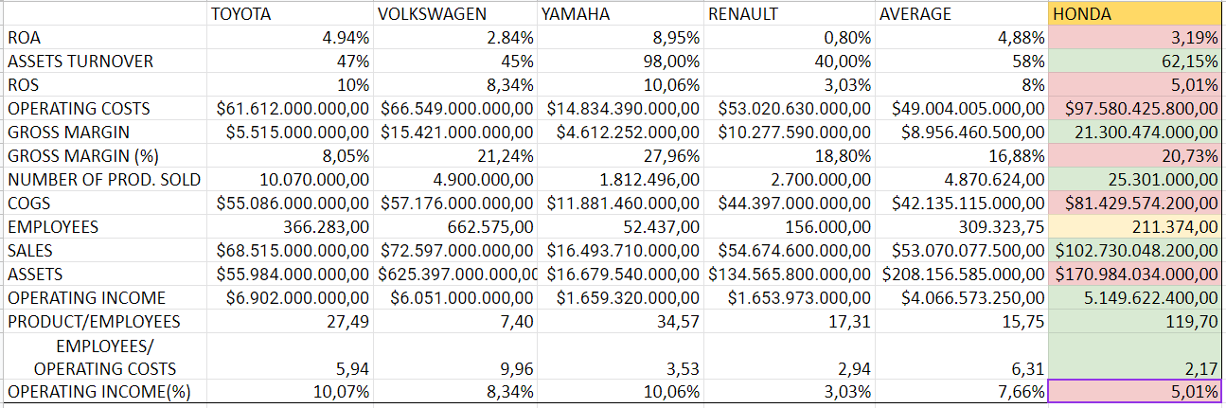
BENCHMARK WITH INDUSTRY
*see PDF/EXCEL for more in depth analysis

Slide 6
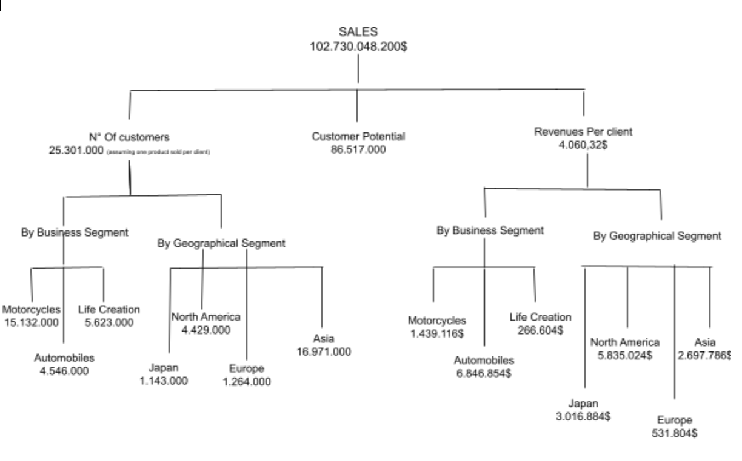
REVENUE MODEL
*see PDF/EXCEL for more in depth analysis

Slide 7
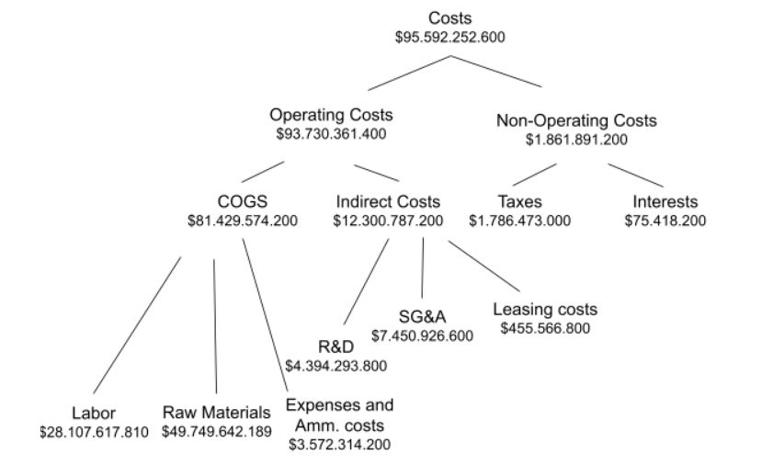
COST MODEL
*see PDF/EXCEL for more in depth analysis

Slide 8
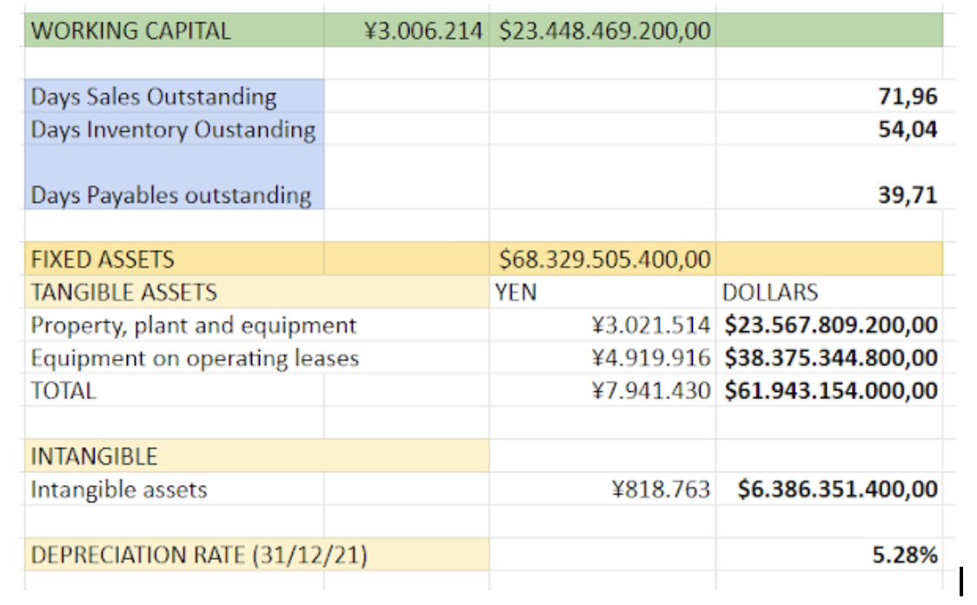
ASSET MODEL
*see PDF/EXCEL for more in depth analysis

Slide 9
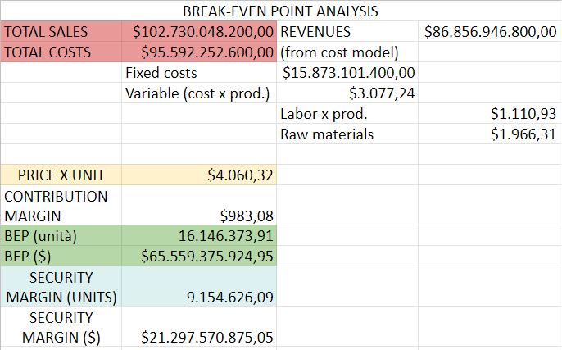
BREAK-EVEN POINT ANALYSIS
*see PDF/EXCEL for more in depth analysis

Slide 10
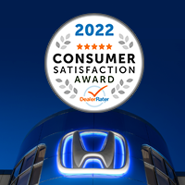
Customer Behaviour Analytics
*see PDF/EXCEL for more in depth analysis
Marketing Mix
Analytics
Honda as “Undisputed no. 1 in customer satisfaction”
Marketing strategy of honda analyses the brand with MM framework which covers the 4Ps.
Honda marketing strategy helps the brand/company to position itself competitively in the market and achieve its business goals & objectives.
Product, 4 business segments: automobile, motorcycle, financial services and power.
Price, pricing strategy by having a car for every segment of the market.
Place and distribution, has a robust sales network with three sales channels.
Promotion use of marketing camping in an aggressive way to be successful in sales.
Honda works to maximize customer satisfaction, by creating customer joy and excitement by providing a level of value that exceeds the expectations of the customer.
To attain this goal Honda offers service in friendly, timely, reliable, affordable and convenient manner. Moreover, to establish lifelong relationships with satisfied customers Honda takes a proactive approach by conducting satisfaction surveys in all product segments.

Slide 11


*see PDF/EXCEL for more in depth analysis
Supply Chain Optimization Analytics
Predictive Quality Analytics
Honda exploits the advantage by using the power of machine learning, the Internet of Things (Iot) and the predictive analytics by relying on Splunk, that turns data into action and predicts wear and tear of machinery to safely and efficiently produce more than 3,400 vehicles every year.
Honda takes part in the CDP’s supply chain program, an international initiative requesting companies for disclosure of information on climate change policies.
Honda uses Predictive Analytics to shift Profitability into High Gear.
So, Honda’s goal is to achieve a sustainable society across the supply chain by:
improving transportation efficiency
reducing CO2 emissions in the transportation of automobile production parts
reducing waste from packaging materials

Slide 12


Digital Platforms
*see PDF/EXCEL for more in depth analysis
Twitch
Honda was the first major car brand with a dedicated Twitch gaming page called Head2Head. Its aim was to reach the audience of Millennials and Gen Z.
Qlik
Honda is using Qlik to streamline business processes and establish a companywide data culture, and to increase efficiency in business operations.

Slide 13
*see PDF/EXCEL for more in depth analysis
Final Considerations
Honda is an international, strong company that was able to overwhelm other big players and becoming a leader of the industry.
Honda revenues have slowed down in the last year but this is just a conjuntural situation due to causes that are external to the company. In the next few years the revenues are forecast to grow again.
Regarding the business segments, the most profitable is the Motorcycle one.
Honda is good in operating with a level of assets that is lower than the ones of the competitors of the same size.
The Working Capital management should be improved trying to work on the ability of the company to collect money in a shorter time.
Regarding costs, the consideration we have is that the cost structure is too heavy and so it needs to be improved by working on the marketing segment and on the digital platforms. Otherwise Honda risks to not fully exploit the benefits generated by its revenue model and its ability of managing the assets in an efficient way.

Slide 14
Thanks for the attention!

